Slide 1
Digital Strategic Business Initiative for RecykAL
Promote a circular economy by digitally transforming Waste Management - connecting waste generators, Eco-friendly Developers, and recyclers.
Submitted by
ALARMELMANGAI KARTHIKEYAN
GH1035926

Slide 2
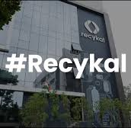
Introduction
About Recykal Tech Private Limited.,
Founder: Abhay Deshpande in 2016
Vision: To build a self-sustaining circular Economy in India.
Mission: Diverse at least 10% waste from the landfills and channel it to recycling and reuse.
Recykal App Statistics:
Market Sellers -10000 users
Buyer app – 1000 users
Recykal DRS – 500 users
Rethink + -1000 users
Recykal –Sathi -1000 users pickup app
​

Slide 3
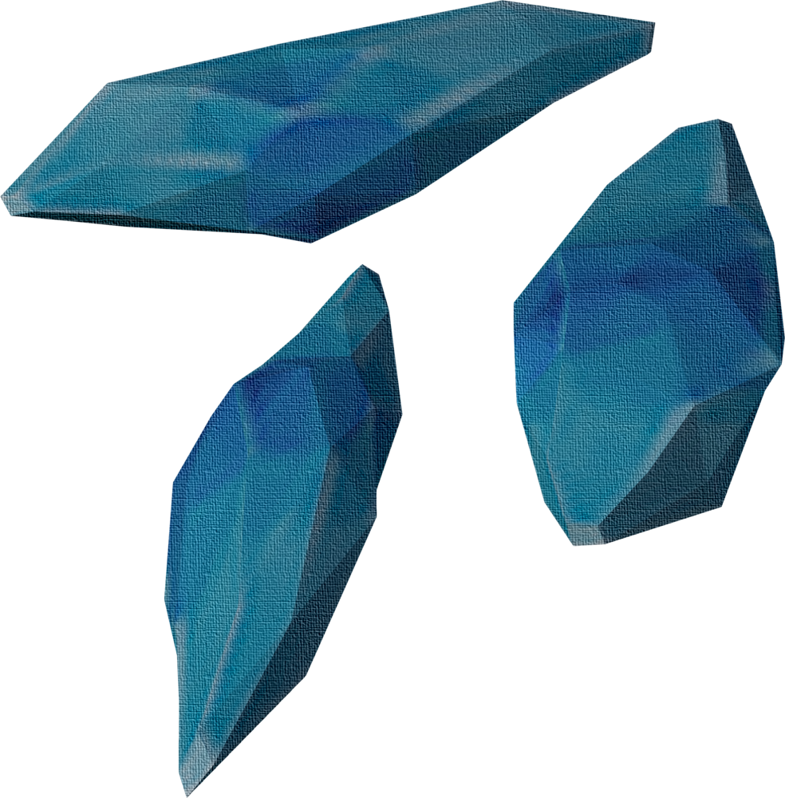



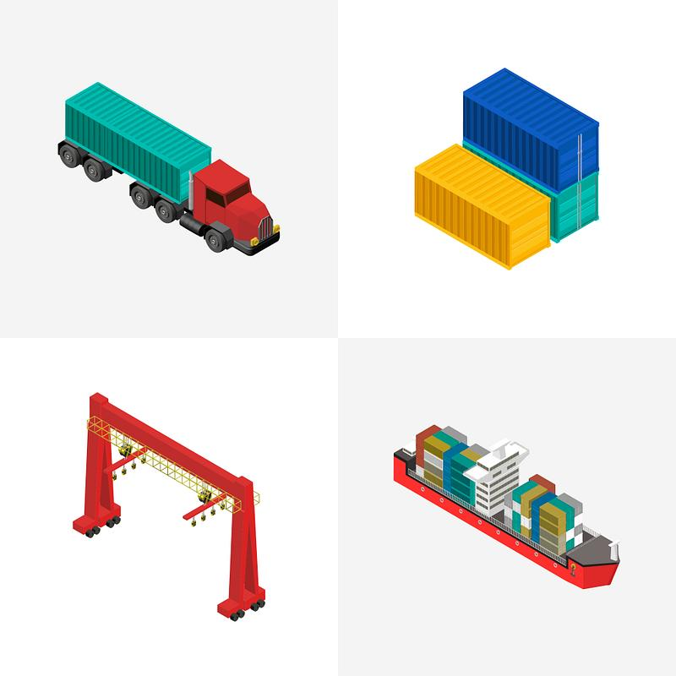





Problem Statement
Limited Waste Categories to Recycle.
No Scope for Reuse.
Inadequate logistic integration.
Poor Tracking and Reporting.
Only Solves B2B Services.
No Solution for Small Quantity Waste.
Lack of Awareness.
Limited to India.
Fragmented Infrastructure for APP.
No Community
Solution
Agriculture waste, Textile waste, Food waste and Construction waste are integrate.
I2B small quantities to local recyclers.
Single Unified Social platform for buyers, Sellers, Logistic operators .
AR – Education Tools.
Expand Globally.
DRS for user
Block chain for Transaction.
IoT integration for Real time logistics.
GPS & Geolocation.
Combine with Startups – reuse.
AI for Waste segregation.

Slide 4
Digital Strategic Business Initiative
Current Performance
Digital waste management B2B.
Provide EPR.
Leverage Technology
AI and ML for Waste Prediction & Sorting
IoT – Real Time Tracking.
Block Chain – Money Transfer Trace-Ability and Transparency. Reward Systems for User.
Geo-Location & GPS - Optimised logistics &Localised Services.
Cloud Computing – AWS and Google Cloud Data analytics & Scalability.
AR Augmented Reality for Education Visualise waste management.
User Engagement & retention rate
Accuracy and Efficiency
Customer Satisfaction
Operational performance metrics
Measure and Optimise
DSBI
Implementation
Develop a Roadmap, for Time phase based implementation of the project
Foster a digital culture
Emphasis Digital Thinking
Encourage Collaboration
Take Data-Driven Decisions
Promote learning and Innovation
Scalable Infrastructure.
Promote Inclusivity.
Objectives
Mobile App with -Smart technology like AI, IoT, Block Chain, Data analytics.
UI/UX Design.
Expand types of waste collection.
Sustainability & Rewards.
Market Research
Identify Customer needs using
Data analytics
Feedback & Surveys
Segmentation & Personalisation.

Slide 5
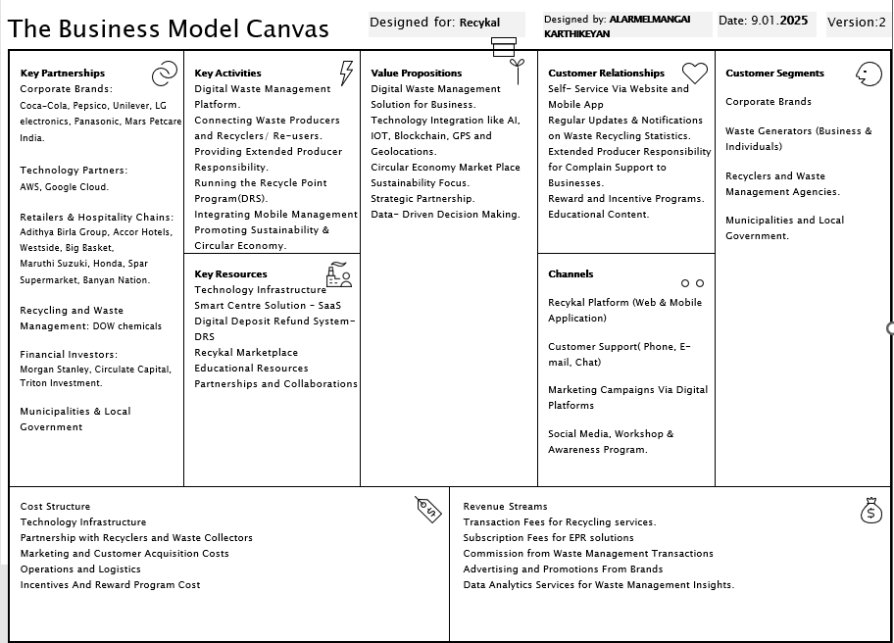
​

Slide 6
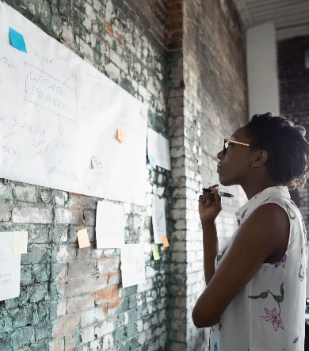

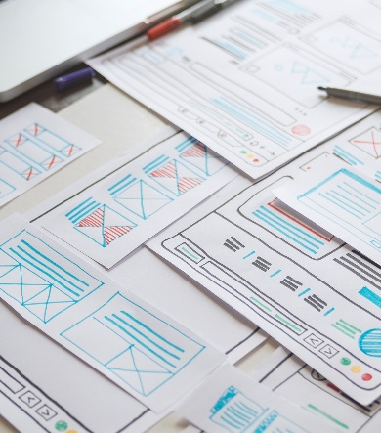
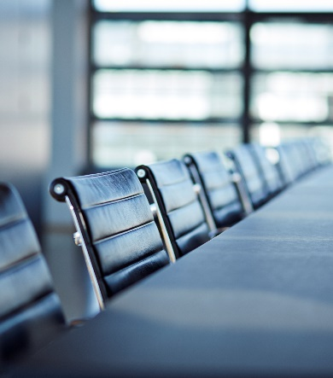
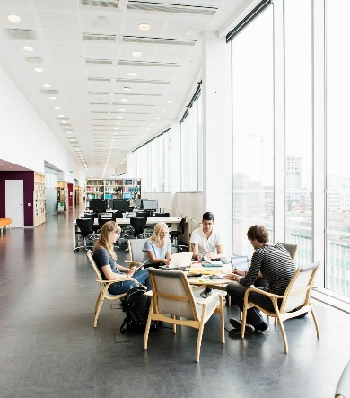
IMPLEMENTATION OF DSBI
Initial Research & Planning (1-2 months)
Core Technology Development (3-6 months)
App Redesign (7-8 months)
Testing & Feature Expansion (9-10 months)
Launch & Global Expansion (11-12 months)
User Research and Data collection.
Define Core Feature.
Technology Feasibility Study.
AI Integration
IoT Sensors
Block chain prototyping
Cloud Infrastructure
UI/UX Redesign
Community Driven Social APP Features
Single platform integration.
Beta Testing
Localized Expansion
Logistic optimization GPS and Geolocation
AR waste sorting Guides
App launch market campaign
Global Expansion South-East Asia & Europe
Post launch optimization and Feedback

Slide 7


User Persona
Flora, 30, Founder of Eco-bridge packaging Startup, Delhi
Raghav , 45
Small-scale Farmer, Punjab.
Goals:
Sells paddy straw (other waste) to earn extra income.
Find Sustainable buyers for crop residue.
Reduce Waste burning that causes environmental pollution.
Challenges:
Lack of Awareness about potential buyers.
Difficulty in connecting with logistics companies to transport the waste.
Tech Proficiency: Basic mobile user for call and messages.
Needs from Recykal: A platform where he can easily list and sell his waste material, get a fair price, connect with logistics companies to handle transportation.
Goals:
Secure a reliable source of paddy straw for their sustainable product transportation.
Build Partnership with local farmers for long term suppy.
Ensure timely delivery and quality of paddy straw for their production needs
Challenges:
Finding consistent, quality suppliers in rural areas.
Managing supply chain logistics to meet production timelines.
Ensuring the sustainability of the raw material.
Tech Proficiency: High; comfortable with technology.
Needs from Recykal: A marketplace to easily connect with farmers, negotiate prices, and track the delivery of paddy straw. Also needs assurance of the material’s quality and sustainability.

Slide 8

Goals:
Get orders for transporting raw materials like paddy straw.
Efficiently manage deliveries to and from rural and urban locations.
Maximize fleet utilization and reduce idle times.
Challenges:
Difficulty in finding consistent orders for transportation.
Managing logistical challenges in remote areas.
Coordinating deliveries with multiple stakeholders (farmers, startups).
Tech Proficiency: Medium; uses mobile apps for logistics management and scheduling.
Needs from Recykal: A platform where he can easily get transportation orders, track deliveries, and receive payment on time. He also needs route optimization features and the ability to connect with farmers and businesses in need of transportation services.
Robin, 39,Logistics company owner (specializes in waste and raw material transportation)
Suburban area near industrial hubs.

Slide 9



Estimated Investment
Technological & Platform Expansion​- $1.5 million
Marketing and User Acquisition- $450,000
Operational Costs Customer Support -$300,000
New waste categories- $150,000
Logistics Module -$200,000
User Engagement -$100,000
Operational and Support -​ $200,000
Maintenance and Updates - $100,000
AI Technology - $500,000
Blockchain Technology - $300,000
Scalability – $200,000
Total for Year 1: $2.25 million

Slide 10
Return on Investment
Subscription model $1million/year
Transaction Commission $1.5 million/year​
Educational content fees - AR
$250,000/Year
Advertisement Fees
$750000​/ Year
Break- even Point: Projected Annual revenue 3.5 million
The investment will break even in approximately 8- 10 months after implementation.
By 3 years, projected revenue could reach $10-15 million/year, driven by scaling user base, additional partnerships and increased adoption.

Slide 11
Measurement of Success in Recykal

Slide 12
Reference
Recykal. (n.d.). Sustainability. Recykal. Available at: https://recykal.com/sustainability (Accessed: 9 January 2025).
Recykal Business App 2025, Google Play Store, viewed 9 January 2025, https://play.google.com/store/apps/details?id=com.recykal.business.
Ionology (2019) Digital Transformation Strategy. Available at: https://www.youtube.com/watch?v=3zDLY6Ulh5U (Accessed: 09 January 2025).
Fang, B., Yu, J., Chen, Z. et al. (2023) ‘Artificial intelligence for waste management in smart cities: a review’, Environmental Chemistry Letters, 21, pp. 1959–1989. https://doi.org/10.1007/s10311-023-01604-3
Sharma, S.K., Bhushan, B., Khamparia, A., Astya, P.N. and Debnath, N.C. (eds.) (2021) Blockchain Technology for Data Privacy Management. CRC Press.

